Slide 1
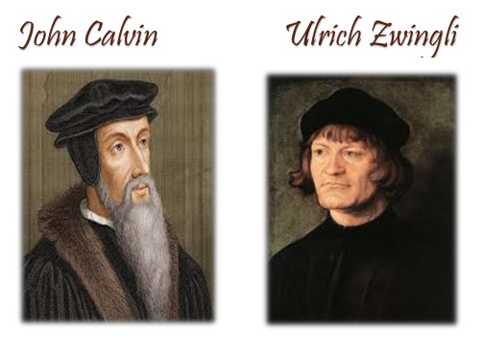
Notes:
The reformation in Switzerland was influenced by two major factors:
First, Switzerland was divided up into 13 cantons (administrative subdivisions) that were independently autonomous and self-governing republics. The government of each canton was completely in charge of local affairs and therefore had a profound impact on the form of religion it would follow.
Second, Swiss cities were full of culture and universities and renaissance humanism became firmly established, causing many to think for themselves rather than having religion forced upon them by the Catholic clergy.
Three branches of reformation theology stemmed from Switzerland. In the Germen speaking north, most followed Ulrich Zwingli’s view of the reformation. In the French speaking south, most followed the views of John Calvin, led by Geneva. Thirdly, some who initially worked with Zwingli eventually formed the Anabaptist movement which we will discuss in a future lesson.

Slide 2
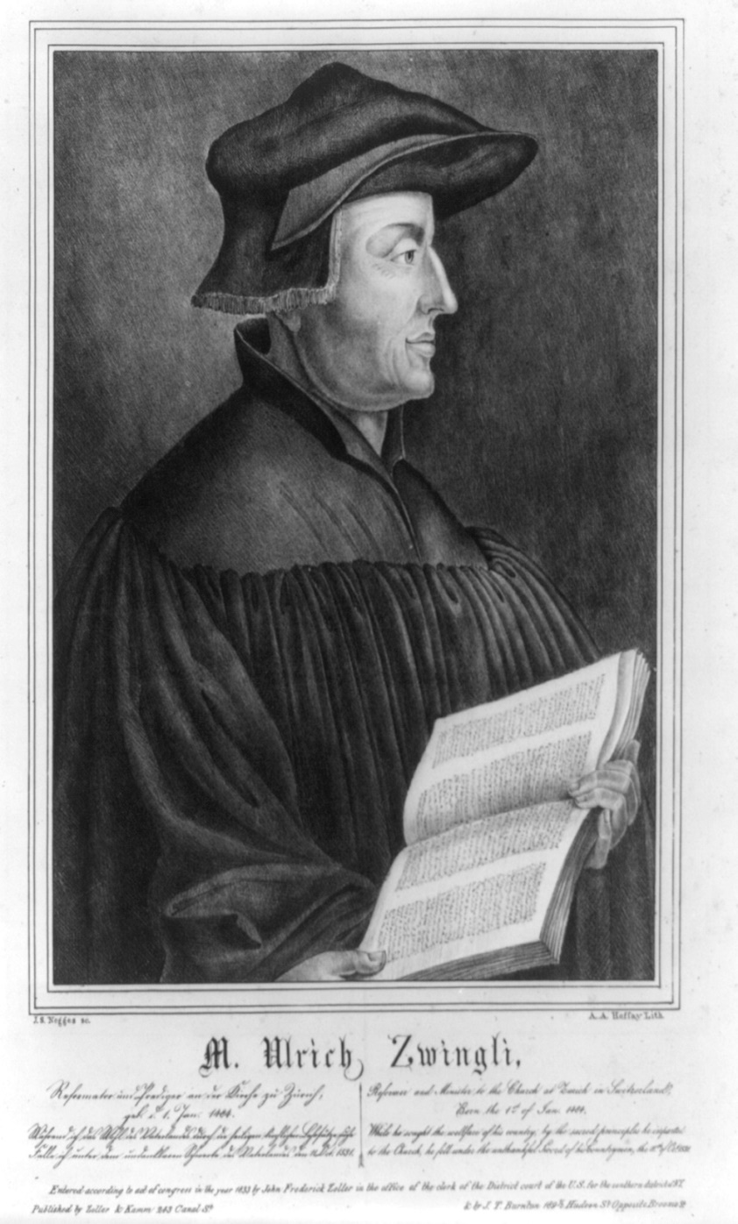
Ulrich Zwingli (1482 – 1531)
Born in German speaking Switzerland
Received a good education
Appointed a parish priest at Glarus in 1506
Appointed chief pastor in the Cathedral Church in Zurich in 1518
Notes:
Ulrich Zwingli was born in German speaking Switzerland and received a good education. He, like Luther, became a priest for the Roman Catholic church and then became the chief pastor at the Cathedral Church in Zurich in 1518. During this time, he began to oppose some of the abuses of the Roman system of indulgences, worship of Mary, tithing (he believed the NT taught that giving should be voluntary), and the celibacy of the clergy. In fact, Zwingli secretly married in 1522 and did not publicize it until 2 years later.

Slide 3
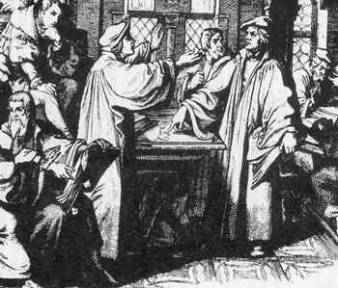
Ulrich Zwingli (1482 – 1531)
Developed idea that the bible is sufficient for doctrinal guidance
In 1519, began a homiletical exposition of the NT in his studies
Preaching from the scriptures was an unheard of innovation in his day – continued for 4 years
Zwingli’s teaching led to the Reformed Churches
Notes:
The renaissance had a major impact on Zwingli and he began to look at the bible with fresh eyes and to see it as the sole and sufficient guide for faith. He began preaching expository sermons from the pulpit, which was unheard of at the time, by reading the passages and then explaining their meaning. He did this for several years and gained a large following. Zwingli’s new found beliefs began to come out of his sermons and he then began speaking out vehemently against Catholic corruption. The Reformation churches came out of this movement.
After winning a debate against Johann Faber in 1523, Zwingli published his “Sixty-seven Articles” emphasizing salvation by faith, the authority of the bible, the headship of Christ, and the right of clergy to marry. His ideas rapidly spread throughout northern Switzerland. Fees for baptisms and burials were eliminated, monks and nuns were allowed to marry, images and relics were banned, and Catholic mass was abolished.

Slide 4
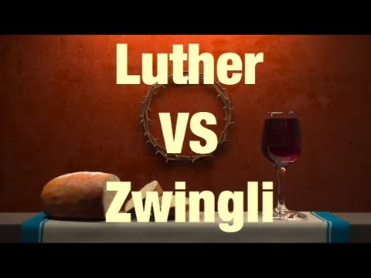
Ulrich Zwingli (1482 – 1531)
Zwingli vs. Luther
Luther retained Catholic ceremonies not positively anti-scriptural
Zwingli rejected anything expressly not enjoined in scripture
Zwingli’s Teachings:
Salvation by faith alone
Denial of sacrificial quality of mass
Denial of saintly intercession
Recognition of Christ as sole head of church
Right of clergy to marry
Abolishing images, relics, and organs in worship
Observance of Lord’s Supper as memorial
Notes:
Eventually, Luther and Zwingli met to discuss doctrine but they had a disagreement. Luther believed you could bring in any teaching that was not positively anti-scriptural whereas Zwingli rejected anything no expressly enjoined in scripture. In other words, to Luther, the silence of scripture was permissive and to Zwingli the silence of scripture was prohibitive. They especially disagreed on the Lord’s Supper where Luther maintained a doctrine similar to Catholicism while Zwingli held the elements to merely be symbols.
Like Luther, though, Zwingli believed in salvation by faith alone. He denied transubstantiation, saintly intercession, the papacy, celibacy of the clergy, images, relics, organs, etc. He strongly believed the Lord’s Supper was a memorial.

Slide 5
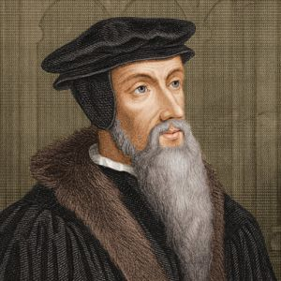
John Calvin (1509 – 1564)
Early Life
Born outside Paris, France. Father was an attorney
Began studying law but after 2 years switched to religion
Devout student of the bible and influenced by the writings of Luther
In 1536, he published “Institutes of the Christian Religion”
Was a leader amongst Paris Protestants but forced to flee to Geneva, Switzerland because of opposition to the king
Rose to power in Geneva
Calvin became a virtual dictator
He endeavored to build Geneva into an ideal city through a system of “Christian Government”
A theological seminary was established in Geneva and from that institution young men went all over Europe preaching the doctrines of Calvin
Notes:
John Calvin is largely regarded as the successor of Martin Luther and widely regarded to have had strongest influence on Protestantism. His father was an attorney and at an early age he decided to follow in his father’s footsteps. However after two years of studying law, he switched to religion. He became a devout student of the bible and was greatly influenced by the writings of Luther. While teaching on his views, he gained a large following of Protestants in Paris but eventually drew the ire of the king and was forced to flee Paris for Geneva Switzerland.
While in Geneva, he wrote his “Institutes of the Christian Religion” where he outlined his view on the sovereignty of scripture and the divine predestination of God….both major tenants in Calvinism today. Though he was forced to leave Geneva in 1538 by anti-protestants, he was invited back again in 1541 and became an important spiritual and political leader…a virtual dictator. He was greatly influenced by Augustine and after Augustine’s book, “City of God”, he sought to build a “Christian government” that he believed would make it an ideal city. He also established a seminary in Geneva where young men were trained and sent all over Europe preaching the doctrines of Calvin, creating Presbyterianism in Scotland, Puritanism in England, and another branch of reformed churches in the Netherlands.

Slide 6
John Calvin (1509 – 1564)
Today, Calvin is known for his “five tenants” (TULIP)
Total Hereditary Depravity
Unconditional Election
Limited Atonement
Irresistibility to Grace
Perseverance of the saints
Notes:
Calvin’s five tenants of teaching were developed into an acronym called “TULIP”. These teachings form a very logical system Calvin believed defined the nature of God as well as God’s relationship to man. These were things that Augustine had taught over a 1000 years before Calvin was born that he simply repackaged into a system. As we will see later, every one of these teachings stem from Calvin’s beliefs regarding the sovereignty of God. Though not all Protestant churches hold to every tenant (except Presbyterians), almost all of them hold to at least one or two.

Slide 7
John Calvin (1509 – 1564)
Calvin remains a controversial figure
“Some think on Calvin heaven’s own mantle fell, while others deemed him an instrument of hell.”
The same attitudes are held today toward what is known as “Calvinism” – some look on it as a blessing and others as one of the major curses of religion
Out of his work, the Presbyterian Church was established (1540AD)
Notes:
Calvin remains one of the most controversial figures in Christian religion even today. While some believe he was one of the biggest blessings for Christendom, others view him as an agent of hell. As we look more closely at TULIP in later slides, we’ll see which side of this argument we should stand on. But Calvin’s followers became what are known today as Presbyterians.

Slide 8
Sovereignty of God
Sovereignty of God
The soil from which the TULIP grows
Sovereignty of God is biblical
Isa 40:13-14 – “Who has directed the Spirit of the Lord, or as His counselor has informed Him? With whom did He consult and who gave Him understanding? And who taught Him in the path of justice and taught Him knowledge and informed Him of the way of understanding?”
Isa 43:13 – “Even from eternity I am He, And there is none who can deliver out of My hand; I act and who can reverse it?”
Isa 45:9-10 – “Woe to the one who quarrels with his Maker—an earthenware vessel among the vessels of earth! Will the clay say to the potter, ‘What are you doing?’ Or the thing you are making say, ‘He has no hands’? Woe to him who says to a father, ‘What are you begetting?’ Or to a woman, ‘To what are you giving birth?’”
However what Calvin taught about God’s sovereignty is not biblical
Calvin: in God’s sovereignty, He has made all choices for man no matter how insignificant
Notes:
The sovereignty of God does not originate from Calvin; it originates from scripture. However Calvin came up with an idea about God’s sovereignty that cannot be proven from scripture, and that is that God is in utter and complete control of everything including the fact that He has already made all of man’s choices for him no matter how insignificant those choices may be. This is the foundation upon which all Calvinistic doctrine is based. Someone once said that it is the “soil” from which the TULIP grows.
While the bible does teach that God is sovereign and in control, the bible also teaches that within the realm of God’s sovereignty He has chosen to give man freewill. In other words, one of the choices God has made is that man has the ability to choose between right and wrong, obeying and disobeying. The entire system of Calvinism stands or falls on this point.

Slide 9
Sovereignty of God
God’s Sovereign Choice Is Man’s Free Will
Deut 30:19 – “I call heaven and earth to witness against you today, that I have set before you life and death, the blessing and the curse. So choose life in order that you may live, you and your descendants.”
Josh 24:15 – “If it is disagreeable in your sight to serve the LORD, choose for yourselves today whom you will serve: whether the gods which your fathers served which were beyond the River, or the gods of the Amorites in whose land you are living; but as for me and my house, we will serve the LORD.”
Rev 22:17 – “The Spirit and the bride say, ‘Come.’ And let the one who hears say, ‘Come.’ And let the one who is thirsty come; let the one who wishes take the water of life without cost.”
Eccl 9:11 – “I again saw under the sun that the race is not to the swift and the battle is not to the warriors, and neither is bread to the wise nor wealth to the discerning nor favor to men of ability; for time and chance overtake them all.”
Jer 7:31 – “They have built the high places of Topheth, which is in the valley of the son of Hinnom, to burn their sons and their daughters in the fire, which I did not command, and it did not come into My mind.”
Notes:
That God, in His sovereignty, has given man freewill is an indisputable point. It is only when Calvinists twist clear passages can they escape this truth.
Deut 30:19 has God calling on mankind to choose life. Calvinists will respond that this is only the “appearance” of choice. This is qualifier of their own making because it is not taught in the text whatsoever. It would be a deception by God to encourage His people to choose life if they couldn’t actually choose life because God had already chosen that some of them would “choose” death. God is pleading with them to choose life because in His sovereignty He has given man the ability to choose life or death.
In Josh 24:15, Joshua understood that the Israelites could choose between serving God or serving idols. When they chose idols, God punished them for it. For God to punish someone for something they had no control over goes against His justice which is a crucial part of His character.
In Rev 22:17, whoever wishes/wills can take the water of life without cost. This is a choice God wishes for everyone. It could not be so if He had already made man’s decisions for him.
In Eccl 9:11, we learn that there are random events and random elements to life. Calvinists believe every event is predetermined by God. Scripture says otherwise. In fact, the wise man teaches that the reason for such random events is so that man will not rely on himself. If I could know that everything I planned would succeed, I wouldn’t recognize my need for God. Therefore God, in His sovereignty, introduces random chance into His creation.
In Jer 7:31, it is clear that God did not choose for man to worship Molech. How did God purpose this while at the same time not commanding it? It is impossible to Calvin’s idea of sovereignty into such a statement without grossly twisting the passage.
Therefore, God is sovereign. But in that sovereignty God is perfectly able to create mankind as free moral agents capable of making choices. This was one of God’s choices that we learn from scripture.

Slide 10
TULIP
Notes:
When Calvin was developing his doctrine, he took the teachings of Augustine and packaged them into an acronym that he believed would make his theology easy to understand. Each letter in the word TULIP stands for one of the main tenants of Calvinism. However, each of these tenants arose from his misinterpretation of God’s Sovereignty.

Slide 11
TULIP
Total Hereditary Depravity
Calvin taught that when Adam & Eve first sinned, they corrupted their God-given perfect nature
Adam & Eve then passed that depraved nature on to their children
This depravity prevents man from doing anything about his salvation
Augustine taught this 1000 years before the reformation movement
Catholic church adopted Augustine’s view and started baptizing infants
Where did Augustine get his view?
A very bad Latin translation that preceded Jerome’s Vulgate
Rom 5:12 – “in Adam” vs. “through/because of Adam”
Notes:
Calvin taught that one of the choices God made for man in His sovereignty is that he would sin and therefore corrupt his nature. Therefore, every person that is born inherits the corrupt nature of Adam and is completely devoid of good. This doctrine is called “Total Hereditary Depravity”. “Total” means altogether. “Hereditary” means it passes from father to son beginning with Adam and continuing down through the generations. “Depravity” means there is no moral/spiritual goodness within. This is what Calvin taught happened to man as a result of Adam’s sin.
Interestingly, this doctrine was taught by Augustine 1000 years before Calvin was even born and one which the Catholic church taught that became the premise for infant baptism. But Augustine adopted this view primarily because he had a very bad Latin translation of the bible. Since Augustine did not speak Greek, he relied on this Latin translation even though it was far inferior to Jerome’s Latin Vulgate which was being worked on in Augustine’s later life. In Augustine’s Latin translation, Rom 5:12 says that “in Adam” all have sinned. Augustine took this literally. However, this was not what the original Greek taught. The Greek says “through” or “because of” Adam all sin. In other words, Augustine took it to mean we inherit Adam’s sin rather than us merely being recipients of the consequences of Adam’s sin.

Slide 12
TULIP
Total Hereditary Depravity
Ezek 18:20 – “The person who sins will die. The son will not bear the punishment for the father’s iniquity, nor will the father bear the punishment for the son’s iniquity; the righteousness of the righteous will be upon himself, and the wickedness of the wicked will be upon himself.”
Eccl 7:29 – “Behold, I have found only this, that God made men upright, but they have sought out many devices.”
Jas 1:13-15 – “¹³Let no one say when he is tempted, ‘I am being tempted by God’; for God cannot be tempted by evil, and He Himself does not tempt anyone. ¹⁴But each one is tempted when he is carried away and enticed by his own lust. ¹⁵Then when lust has conceived, it gives birth to sin; and when sin is accomplished, it brings forth death.”
Isa 1:18 – “‘Come now, and let us reason together,’ says the Lord.”
Notes:
The doctrine of THD is emphatically denied in scripture and there are clear passages that prove so.
In Ezek 18, Ezekiel is dealing with a misconception amongst the Jews. The misconception is that they were in captivity as the result of what their ancestors did with no fault of their own. God makes it clear that you cannot inherit your father’s guilt and your father cannot inherit your guilt. The person who sins will die.
In Eccl 7:29, the wise man makes it clear that men are made upright, but it is when he seeks after many devices/schemes that his uprightness becomes sin.
In Jas 1:13-15, James described sin as something that is committed by each individual when he is tempted and then gives in to that temptation. Nowhere is sin talked about here or anywhere else in scripture as a state that is inherited independent of our decisions.
In Luke 1:18, would God have man reason with Him if he is incapable of doing such as a result of his depraved nature?
Therefore, we conclude that each person is responsible for his own sin and no one else’s. Sin is an action committed, not a state inherited.

Slide 13
TULIP
Unconditional Election
Since man is incapable of goodness, he can’t choose for himself to be saved
God individually chooses who will be saved/condemned. We can’t change this
Reasoning: to make God look good
“How will I show men how holy I am? I’ll decide to create man and then cause them all to sin. I’ll then condemn certain of those men and save others. By doing this, men will be able to see a contrast between wickedness and righteousness and they will see My character.”
The bible does teach predestination (individual or collective?)
Eph 1:5 – “He predestined us to adoption as sons through Jesus Christ to Himself, according to the kind intention of His will.”
Notes:
Calvin then taught that since man is totally and hereditarily depraved, he has no goodness with him and therefore cannot choose any conditional outside of his own will by which he could be saved – God was going to have to choose this for him. Therefore since God’s choice is not based on any condition of man (because man’s condition is depraved), that led to the doctrine of Unconditional Election. If you are of the elect, you will go to heaven. If you are not, you will go to hell. There is nothing man can do to change either decision of God’s.
Calvin’s reasoning behind this doctrine was that it was God’s way of showing how holy and righteous He is. In other words, God creates man and causes man to sin. From that group, He will then select particular ones to save and particular ones to condemn for all eternity. When man sees the contrast between righteousness an wickedness, they will see God’s holiness and righteousness.
The bible does teach predestination (Eph 1:5), just not to the degree that Calvin taught. Calvin taught individual predestination. The bible teaches a collective predestination, that God determined a set of boundaries and standards by which men would be saved. Those who obey the gospel are predetermined by God to be in Christ’s circle.

Slide 14
TULIP
Unconditional Election
Acts 10:34 – “Opening his mouth, Peter said: ‘I most certainly understand now that God is not one to show partiality.’”
2 Pet 3:9 – “The Lord is not slow about His promise, as some count slowness, but is patient toward you, not wishing for any to perish but for all to come to repentance.”
1 Tim 2:3-4 – “This is good and acceptable in the sight of God our Savior, who desires all men to be saved and to come to the knowledge of the truth.”
Rom 11:17-20 – “¹⁷But if some of the branches were broken off, and you, being a wild olive, were grafted in among them and became partaker with them of the rich root of the olive tree, ¹⁸do not be arrogant toward the branches; but if you are arrogant, remember that it is not you who supports the root, but the root supports you. ¹⁹You will say then, ‘Branches were broken off so that I might be grafted in.’ ²⁰Quite right, they were broken off for their unbelief, but you stand by your faith. Do not be conceited, but fear.”
Notes:
In Acts 10:34, Peter concluded that God is not one to show partiality toward mankind. How would someone inspired by God’s Holy Spirit determine this to be true if Calvin’s idea of individual predestination is correct? Peter should have known otherwise what apparently Augustine came up with hundreds of years later.
In 2 Pet 3:9, we learn that God does not want to anyone to perish, but for all to come to repentance. How could He individually determine who is going to be saved and condemned while at the same time wanting all men everywhere to be saved?
In 1 Tim 2:3-4, God again is found to be one who desires all men to be saved. Is this just the “appearance” of desire as Calvinists like to say? Does my “depraved nature” prevent me from understanding a simple statement such as this?
In Rom 11:17-20, there is an illustration made about the Jews and Gentiles, that the Jews were cut off while he Gentiles were grafted in. Vs. 20 is clear that the reason for them being broken off is unbelief and not God’s predetermined decision.

Slide 15
TULIP
Limited Atonement
Since man’s election is unconditional, Christ did not die for all men
The atonement that comes from Christ’s blood is limited to those unconditionally elected
Calvin taught Christ’s blood is capable of saving all men
He went further by suggesting God purposed it merely to save the individually elected
Notes:
This doctrine is directly related to what Calvin taught about Unconditional Election. He believed that since men are unconditionally elected, Christ did not die for all men. In other words, the atonement that comes as a result of Christ’s blood is limited to the elect. Calvin did not teach that Christ’s blood was insufficient to save mankind, only that God purposed for it to merely save the elect.

Slide 16
TULIP
Limited Atonement
1 John 2:2 – “And He Himself is the propitiation for our sins; and not for ours only, but also for those of the whole world.”
2 Cor 5:14-15 – “For the love of Christ controls us, having concluded this, that one died for all, therefore all died; and He died for all, so that they who live might no longer live for themselves, but for Him who died and rose again on their behalf.”
Heb 2:9 - But we do see Him who was made for a little while lower than the angels, namely, Jesus, because of the suffering of death crowned with glory and honor, so that by the grace of God He might taste death for everyone.
Notes:
In 1 John 2:2, we are told that Christ is the propitiation for the sins of the entire world. There is no way Calvin’s idea of limited atonement can stand up next to a straight-forward passage such as this.
In 2 Cor 5:14-15, Jesus is referred to as having died for all. Calvin would say this was merely all the “elect”. But the import of the passage suggests all mankind can be recipients of Christ’s death.
In Heb 2:9, we’re told that Christ would taste death for everyone, not just an “elect”. We’re also told this is a result of God’s grace which implies it is a gift He is provided all of mankind.

Slide 17
TULIP
Irresistible Grace
Since God’s will can’t be thwarted, those who are chosen will be saved and no obstacle can keep them from being saved
The elect are saved by the grace of God and since it can’t be otherwise, this grace is said to be “irresistible”
Notes:
Calvin believed that since God’s will can’t be thwarted, those who are chosen will be saved and no obstacle can keep them from being saved. Therefore, Calvin taught that the grace of God is irresistible to those whom God elects to be saved.
What makes this doctrine clever is that it is true we cannot resist God’s power. Pharaoh learned this in the book of Exodus when he realized he could not resist God’s will for His people to leave Egypt. However, God does give man free-will to choose while at the same time using his power at selected moments in history to persuade when in certain directions (as was the case with Pharaoh). That God can persuade men in a particular direction does not mean that His grace cannot be resisted, as we’ll see in scripture.

Slide 18
TULIP
Irresistible Grace
Matt 23:37 – “Jerusalem, Jerusalem, who kills the prophets and stones those who are sent to her! How often I wanted to gather your children together, the way a hen gathers her chicks under her wings, and you were unwilling.”
Acts 7:51 – “You men who are stiff-necked and uncircumcised in heart and ears are always resisting the Holy Spirit; you are doing just as your fathers did.”
Acts 13:46 – “Paul and Barnabas spoke out boldly and said, ‘It was necessary that the word of God be spoken to you first; since you repudiate it and judge yourselves unworthy of eternal life, behold, we are turning to the Gentiles.’”
Notes:
In Prov 1:23-24, God makes it clear that when He calls us, we can refuse that calling. When He stretches out His hand, we can pay no attention. In other words, we can choose whether to obey or not obey God and He does not force us in this regard.
In Matt 23:37, Jesus rebukes the people of Jerusalem for the many times He wanted to care for them yet they were unwilling. How could they be unwilling if the grace of God is truly irresistible?
In Acts 7:51, Stephen rebukes the Jews and insists they had resisted the Holy Spirit. Yet Calvin taught this cannot be the case. Who was in a better position to know, Stephen, who had the Holy Spirit, or Calvin, who came on the scene 1400 years later?
In Acts 13:46, Paul and Barnabas claimed that the reason the Jews were not believers is that they repudiated and judged themselves unworthy of eternal life. How could they have made this decision about themselves if God’s grace is irresistible to the elect?

Slide 19
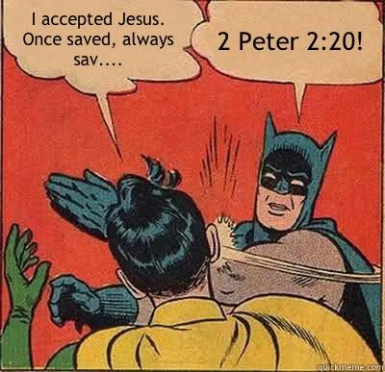
TULIP
Perseverance of the Saints
Since the saints are chosen by God to be saved, their salvation cannot be in doubt
No sin we may commit will keep us out of heaven
If a person “falls away”, Calvinists claim he was never saved to begin with
Notes:
The “P” in “TULIP” stands for “Perseverance of the Saints” which is also referred to as “Once Saved Always Saved”. Calvin taught that since the saints are chosen by God to be saved and that the decision does not rest with us, regardless of anything they may do, their salvation cannot be in doubt. This whole idea is wrapped up in Calvin’s view of the Sovereignty of God in that God will not change His mind about this. Therefore the “elect” will persevere. If he is one of the elect, he cannot become one of the unelect. If he is saved, he cannot be unsaved.

Slide 20
TULIP
Perseverance of the Saints
Gal 5:4 – “You have been severed from Christ, you who are seeking to be justified by law; you have fallen from grace.”
Heb 6:4-6 – “For in the case of those who have once been enlightened and have tasted of the heavenly gift and have been made partakers of the Holy Spirit, and have tasted the good word of God and the powers of the age to come, and then have fallen away, it is impossible to renew them again to repentance, since they again crucify to themselves the Son of God and put Him to open shame.”
2 Pet 2:20-22 – “For if, after they have escaped the defilements of the world by the knowledge of the Lord and Savior Jesus Christ, they are again entangled in them and are overcome, the last state has become worse for them than the first. For it would be better for them not to have known the way of righteousness, than having known it, to turn away from the holy commandment handed on to them. It has happened to them according to the true proverb, “A dog returns to its own vomit,’ and, “A sow, after washing, returns to wallowing in the mire.”
Notes:
The bible definitely teaches that saints can so sin as to be lost and there are many passages that teach this.
In Gal 5:4, Paul is talking to Christians who have become severed from Christ and fallen from grace. You cannot be severed from something unless you were apart of that something. You cannot fall from grace unless you were at one time a recipient of grace.
In Heb 6:4-6, how could these people not be saved if they were partakers of the Holy Spirit? But even after this you can fall away. According to this verse, this person was saved but is overcome by the sin to such a level that they cannot return.
In 2 Pet 2:20-22, Calvinists will claim that such a person was never saved to begin with. But Peter says they had escaped the defilements of the world. He said they did so by the knowledge of Jesus Christ. But he says they were again entangled in sin. If they were never saved, there would be no “again” – they would have always been entangled. The word “again” implies they had been separated from that state unto salvation proper to the second time they were entangled.

